Slide 1
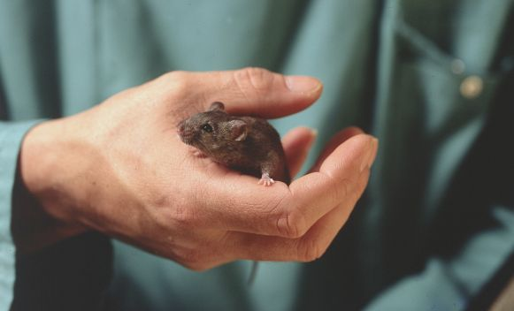
Image source: Understanding Animal Research
Care-full Stories: Post-a-pledge

Slide 2
Key takeaway:
Note to self:
My biggest takeaway from today was…
Based on this, I will make more of an effort to…

Slide 3
Image source: Understanding Animal Research
Care-full Stories: Promoting a culture of care

Slide 4
Care-full Stories
How to promote a culture of care…

